Slide 1
Q-Sparse: All Large Language Models can be Fully Sparsely-Activated
Xiusheng, Huang
July. 23, 2024

Slide 2
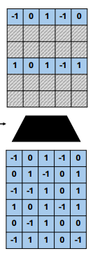
Q-Sparse
a simple yet effective approach to training sparsely activated large language models (LLMs).
(arxiv.org)https://arxiv.org/pdf/2407.10969

Slide 3
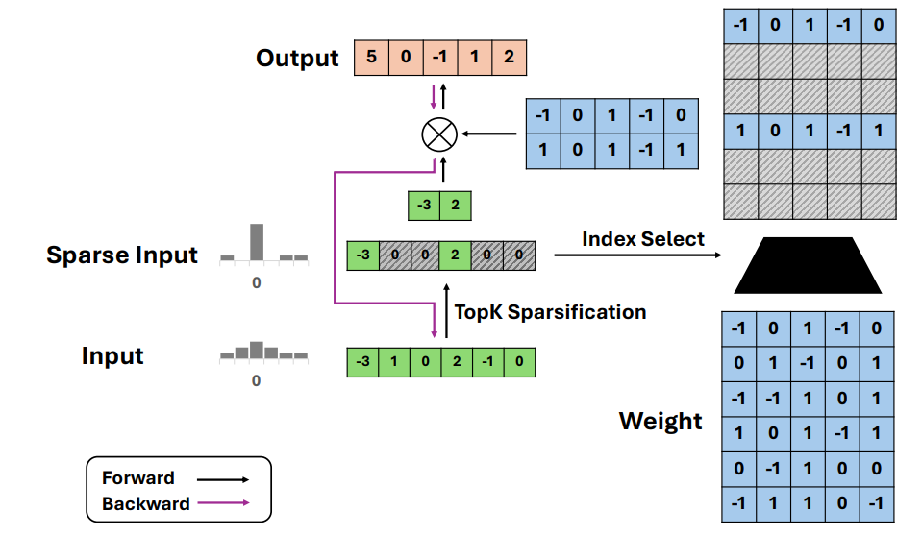
Q-Sparse
Motivation: To enable full sparsity of activations in LLMs.
Q-Sparse Operation: Q-Sparse achieves a superior inference-optimal scaling law than the dense models. It saves significant compute of matrix multiplication by top-K sparsification of the activations.

Slide 4
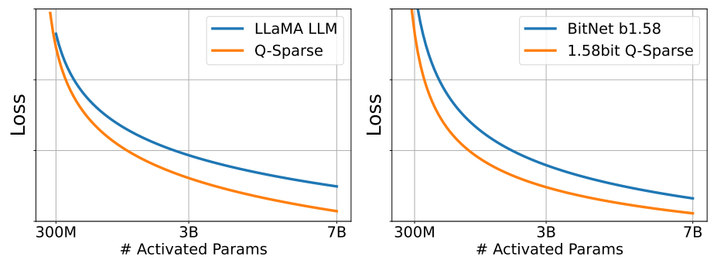
Q-Sparse
Application models: Q-Sparse can be used with both full-precision and low-bit LLMs

Slide 5
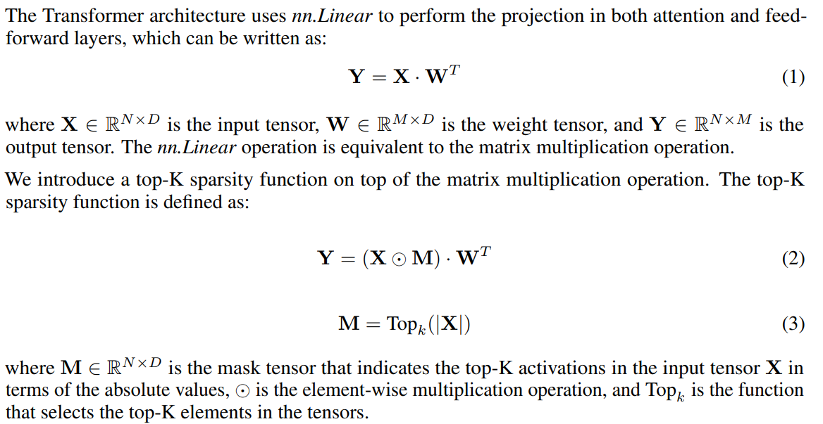
Q-Sparse: Architecture
Architecture : The Q-Sparse architecture is based on the Transformer architecture with modifications to enable sparsity in the activations.
Top-K Sparsity:

Slide 6
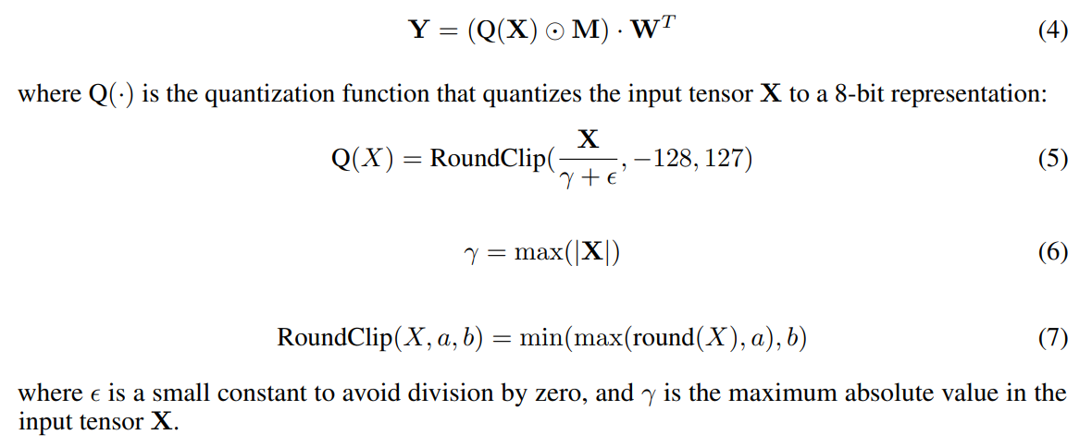
Q-Sparse: Architecture
Architecture : The Q-Sparse architecture is based on the Transformer architecture with modifications to enable sparsity in the activations.
Quantized Top-K Sparsity:
(1) Quantify X
nn.Linear

Slide 7
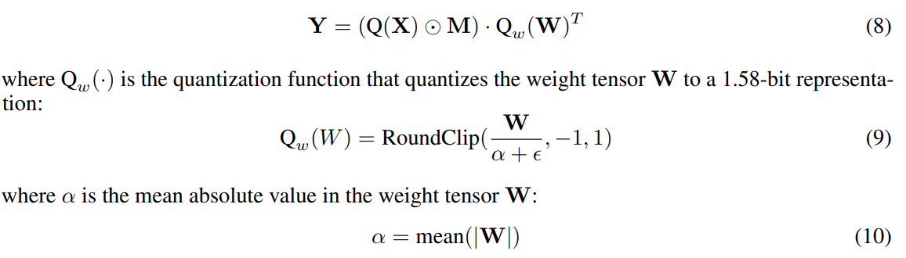
Q-Sparse: Architecture
Architecture : The Q-Sparse architecture is based on the Transformer architecture with modifications to enable sparsity in the activations.
Quantized Top-K Sparsity:
(1) Quantify X
(2) Quantify W

Slide 8

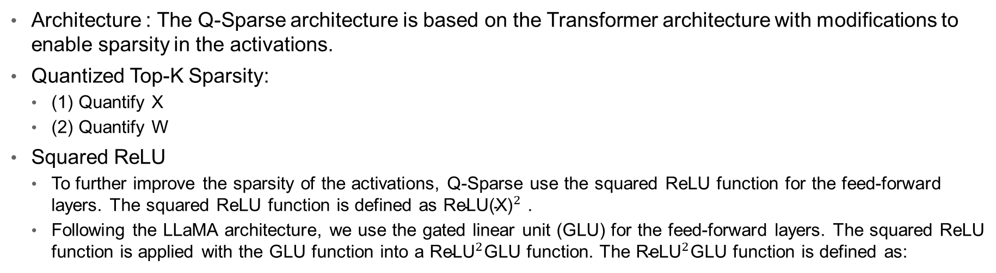
Q-Sparse: Architecture
Architecture : The Q-Sparse architecture is based on the Transformer architecture with modifications to enable sparsity in the activations.
Quantized Top-K Sparsity:
(1) Quantify X
(2) Quantify W
Squared ReLU
To further improve the sparsity of the activations, Q-Sparse use the squared ReLU function for the feed-forward layers. The squared ReLU function is defined as ${\text{ReLU}\text{(}\text{X}\text{)}}^{2}$ .
Following the LLaMA architecture, we use the gated linear unit (GLU) for the feed-forward layers. The squared ReLU function is applied with the GLU function into a ${\text{ReLU}}^{2}$GLU function. The ${\text{ReLU}}^{2}$GLU function is defined as:

Slide 9
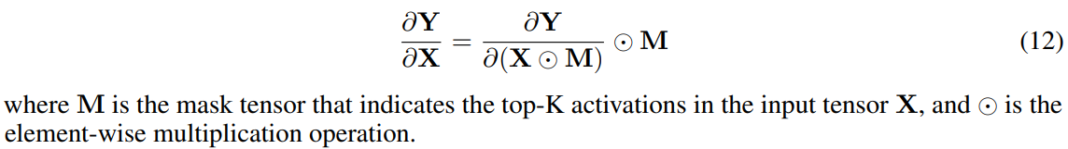
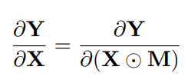
Q-Sparse: Architecture
Architecture : The Q-Sparse architecture is based on the Transformer architecture with modifications to enable sparsity in the activations.
Quantized Top-K Sparsity:
(1) Quantify X
(2) Quantify W
Squared ReLU
Training : Most of the existing works on training sparsely-activated models use the vanilla backpropagation algorithm to compute the gradient through the sparsity function:
The vanilla back-propagation algorithm has a limitation. It zero-outs the gradients of the non-activated elements, which can lead to the vanishing gradient problem, especially when the sparsity ratio is high.
Straight-Through Estimator(STE):

Slide 10
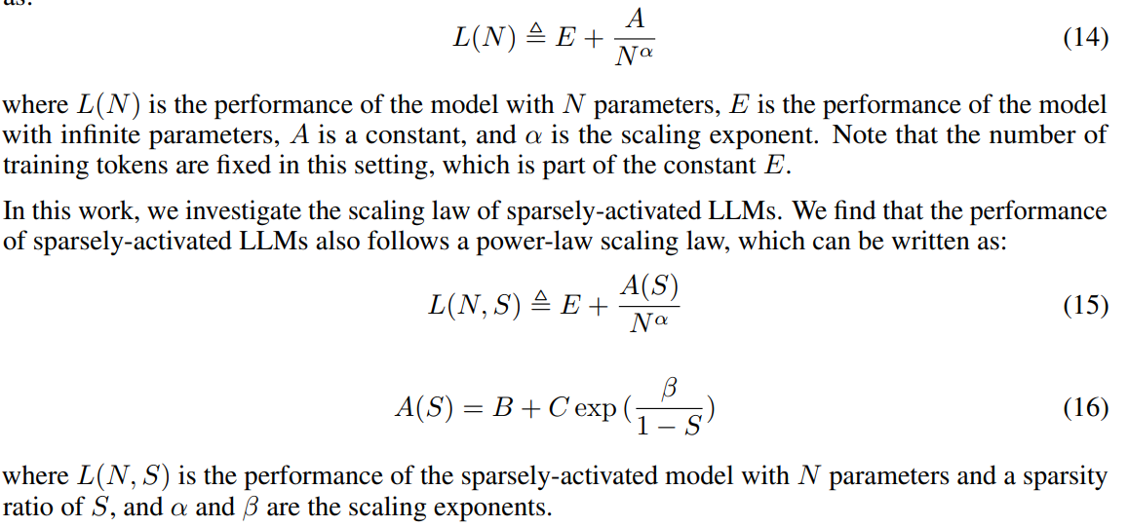
Q-Sparse: Scaling Laws
Scaling Laws : They present an inference-optimal scaling law for sparsely-activated LLMs
Transformer model with N parameters follows a power-law scaling law, which can be written as:

Slide 11
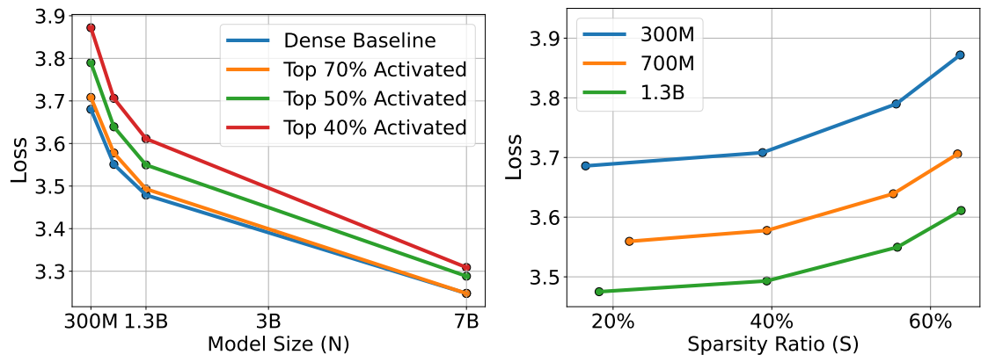
Q-Sparse: Scaling Laws
Scaling Experiments and Findings: As the parameters N scales, the performance gap between the sparsely-activated models and the dense baselines decreases.

Slide 12


Q-Sparse: Scaling Laws
Power Law in the Model Size N
The scaling function can be written as:
where α is the scaling exponent, and the scaling factor A(S) is a function of the sparsity ratio S. The N is the model size.
Exponential Law in the Sparsity Ratio S
The scaling factor A(S) can be written as:
where B is the scaling factor for extremely sparse LLMs, C is the scaling factor for dense LLMs, and β is the scaling exponent of the scaling factor A(S) with regards to the sparsity ratio S.

Slide 13
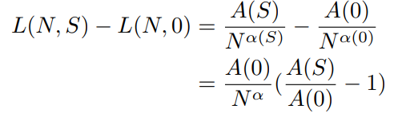


Q-Sparse: Scaling Laws
Diminishing Gap between Sparsely-Activated Models and Dense Baselines
The performance gap can be written as:
Since α is a constant that satisfies α > 0, the performance gap decreases as the model size N scales.
Inference-Optimal Scaling Law
The scaling law can also be transformed into a form that is dependent on the activated parameters Na：
Since A(S) is an increasing function and (1 − S) α is a decreasing function, there exists a sparsity ratio S ∗ > 0 that minimizes the loss of the sparsely-activated models：
They further solve the optimal sparsity ratio S ∗ , finding that S ∗ ≈ 45.58%.

Slide 14
Q-Sparse: Experiments
Experiments（1）：Training-from-Scratch
Experiments（2）：Continue-Training
Experiments（3）：Supervised Finetuning

Slide 15
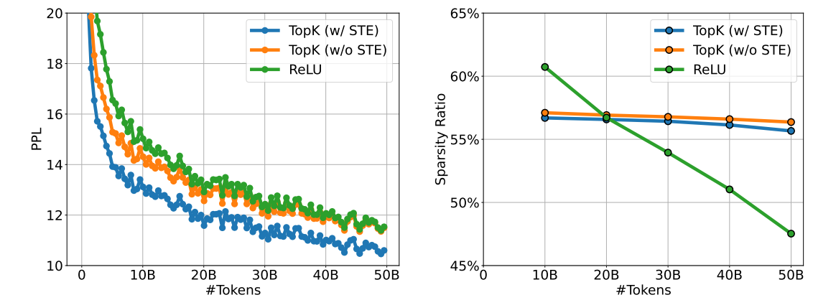
Q-Sparse: Experiments
Experiments（1）：Training-from-Scratch
As show in figure，It shows that either removing STE or replacing with ReLU function significantly hurt the performance. Besides, the sparsity ratio of the models with the ReLU function decreases as the training processes.
The training loss curves (Left) and the overall sparsity ratio (Right) of different sparsity functions. All models are trained with 300M size and 50B tokens.

Slide 16
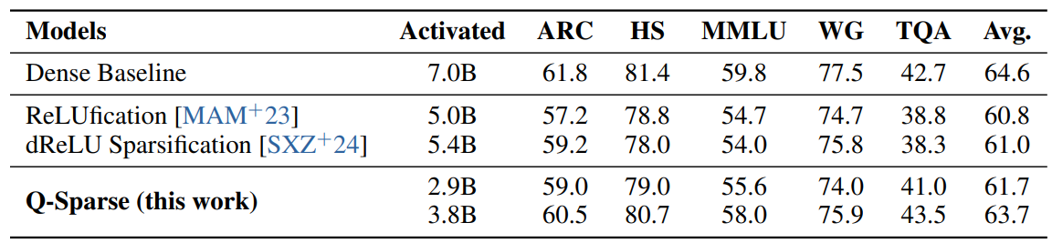
Q-Sparse: Experiments
Experiments（2）：Continue-Training
Results are shown in Table 1. It shows that Q-Sparse achieves comparable performance to the dense baseline while being much more efficient at inference time.
Table 1：The results of the continue-training for Q-Sparse and the baselines on the end tasks

Slide 17
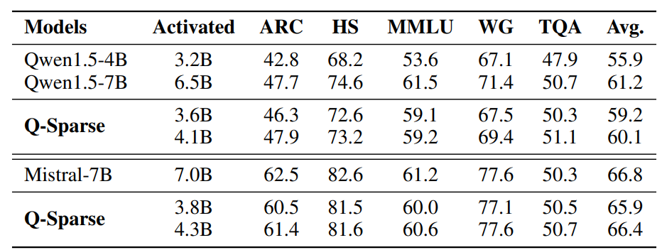
Q-Sparse: Experiments
Experiments（3）：Supervised Finetuning
The results are shown in Table 2. It shows that Q-Sparse with 3.6B activated parameters achieves significant better performance than the Qwen1.5 4B dense model.
Table 2：The results of the continue-training for Q-Sparse and the baselines on the end tasks

Slide 18
Summary
Main contributions:
Q-Sparse can achieve results comparable to those of baseline LLMs while being much more efficient at inference time
They present an inference-optimal scaling law for sparsely-activated LLMs
Q-Sparse is effective in different settings, including training-from-scratch, continue-training of off-the-shelf LLMs, and fine-tuning
Q-Sparse works for both full-precision and 1-bit LLMs

